Slide 1
Workflows: from Development to Automated Production Friday morning, 10:30 am
Christina Koch ckoch5@wisc.edu
Research Computing Facilitators
University of Wisconsin - Madison

Slide 2
Or, Getting the most out of workflows, part 2

Slide 3
Building a Good Workflow
Draw out the general workflow
Define details (test ‘pieces’ with HTCondor jobs)
divide or consolidate ‘pieces’
determine resource requirements
identify steps to be automated or checked
Build it modularly; test and optimize
Scale-up gradually
Make it work consistently
What more can you automate or error-check?
(And remember to document!)

Slide 4
To Get Here …
(special transfer)
file prep and split
(POST-RETRY)
1 GB RAM
2 GB Disk
1.5 hours
. . .
100 MB RAM
500 MB Disk
40 min
(each)
process ‘0’
(filter output)
process ‘99’
(filter output)
(POST-RETRY)
(POST-RETRY)
(PRE)
combine, transform results
(POST-RETRY)
300 MB RAM
1 GB Disk
15 min

Slide 5
Start Here
. . .
process ‘0’
(filter output)
process ‘99’
(filter output)

Slide 6
Add a Step
. . .
process ‘0’
(filter output)
process ‘99’
(filter output)
combine, assess results

Slide 7
And Another Step
prep conditions and/or split data
. . .
process ‘0’
(filter output)
process ‘99’
(filter output)
combine, assess results

Slide 8

End Up With This?
?
DATA

Slide 9
Building a Good Workflow
Draw out the general workflow
Define details (test ‘pieces’ with HTCondor jobs)
divide or consolidate ‘pieces’
determine resource requirements
identify steps to be automated or checked
Build it modularly; test and optimize
Scale-up gradually
Make it work consistently
What more can you automate or error-check?
(And remember to document!)

Slide 10
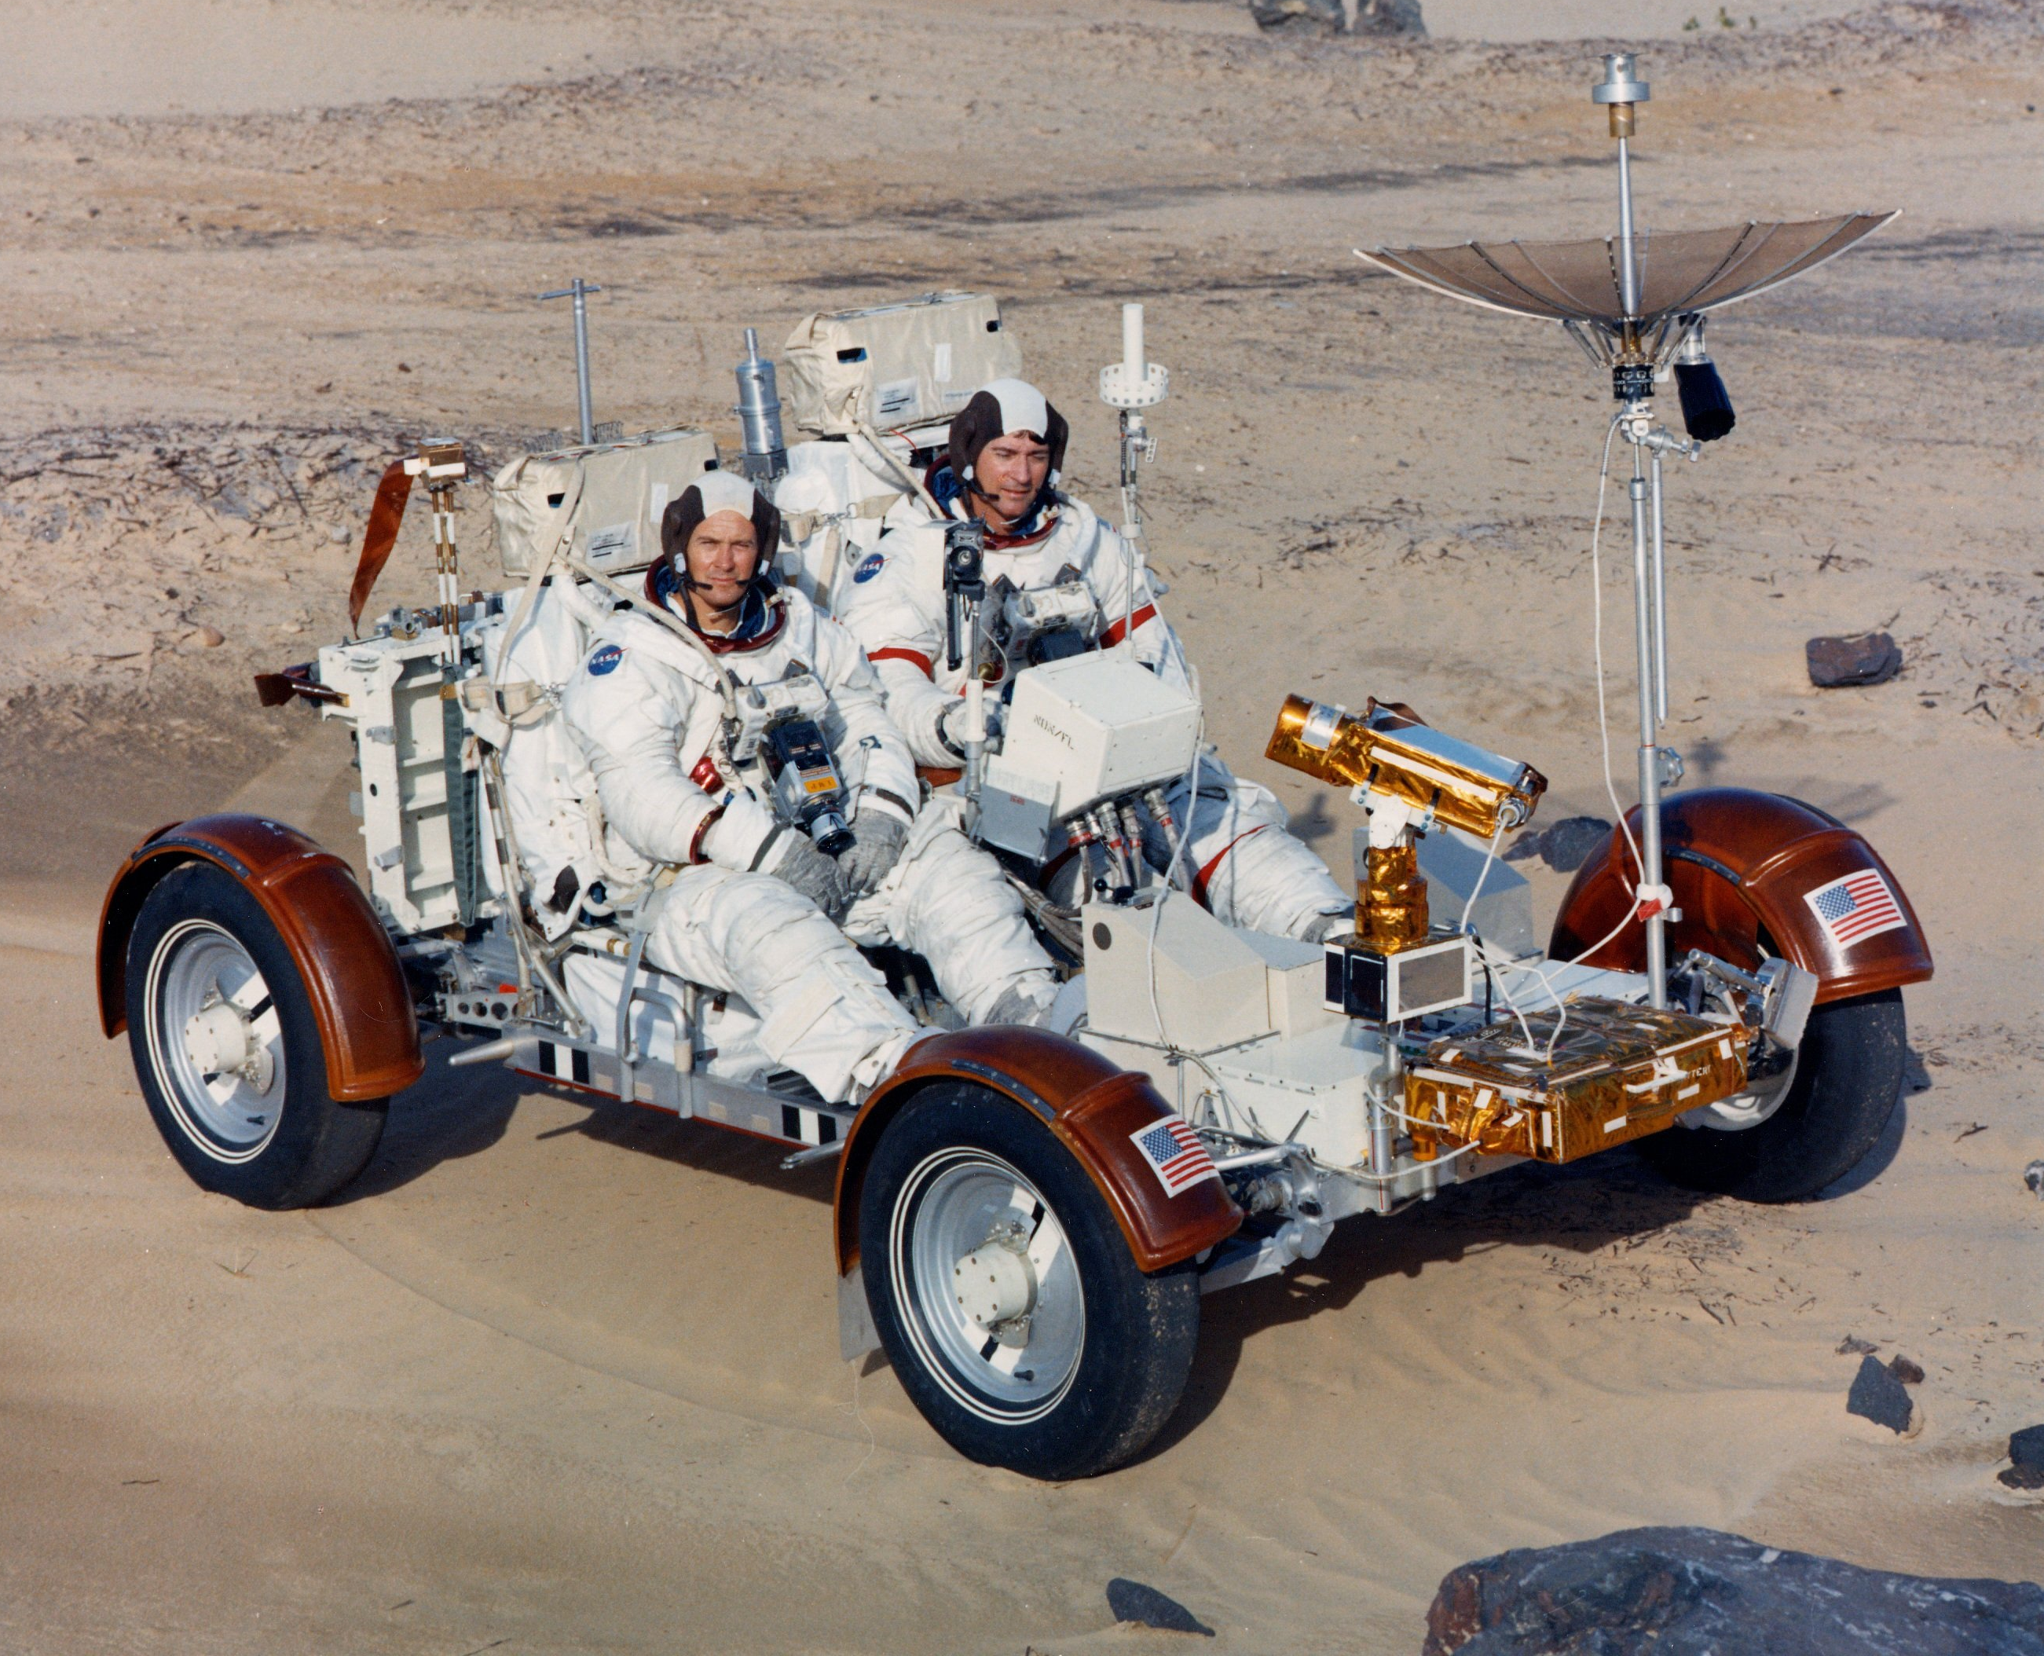
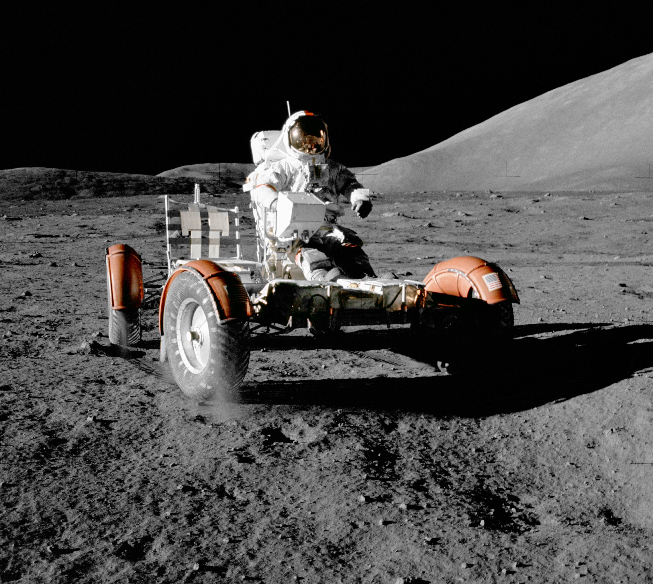
Scaling Workflows
Your (“small”) DAG runs! Now what?
Need to make it run full scale
to the
moon!

Slide 11
Scaling Up: OSG Rules of Thumb
CPU (single-threaded)
Best jobs run between 10 min and 10 hrs
(Upper limit somewhat soft)
Data (disk and network)
Keep scratch working space < 20 GB
Intermediate needs (/tmp?)
Use alternative data transfer appropriately
Memory
Closer to 1 GB than 8 GB

Slide 12
Testing, Testing, 1-2-3 …
ALWAYS test a subset after making changes
How big of a change needs retesting?
Scale up gradually
Avoid making problems for others (and for yourself)

Slide 13
Scaling Up - Things to Think About
More jobs:
100-MB per input files may be fine for 10 or 100 jobs, but not for 1000 jobs. Why?
most submit queues will falter beyond ~10,000 total jobs
Larger files:
more disk space, perhaps more memory
potentially more transfer and compute time
Be kind to your submit and execute nodes and to fellow users!

Slide 14
Solutions for More Jobs
Use a DAG to throttle the number of idle or queued jobs (“max-idle” and/or “DAGMAN CONFIG”)
new HTCondor options to do this in a submit file as well
Add more resiliency measures
“RETRY” (works per-submit file)
“SCRIPT POST” (use $RETURN, check output)
Use SPLICE, VAR, and DIR for modularity/organization

Slide 15
Solutions for Larger Files
File manipulations
split input files to send minimal data with each job
filter input and output files to transfer only essential data
use compression/decompression
Follow file delivery methods from yesterday for files that are still “large”

Slide 16
Self-Checkpointing
Solution for long jobs and “shish-kebabs”
Changes to your code
Periodically save information about progress to a new file (every hour?)
At the beginning of script:
If progress file exists, read it and start from where the program (or script) left off
Otherwise, start from the beginning
Change to submit file:
when_to_transfer_output = ON_EXIT_OR_EVICT

Slide 17
Building a Good Workflow
Draw out the general workflow
Define details (test ‘pieces’ with HTCondor jobs)
divide or consolidate ‘pieces’
determine resource requirements
identify steps to be automated or checked
Build it modularly; test and optimize
Scale-up gradually
Make it work consistently
What more can you automate or error-check?
(And remember to document!)

Slide 18
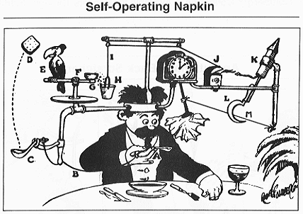
Robust Workflows
Your DAG runs at scale! Now what?
Need to make it run everywhere, everytime
Need to make it run unattended
Need to make it run when someone else tries

Slide 19
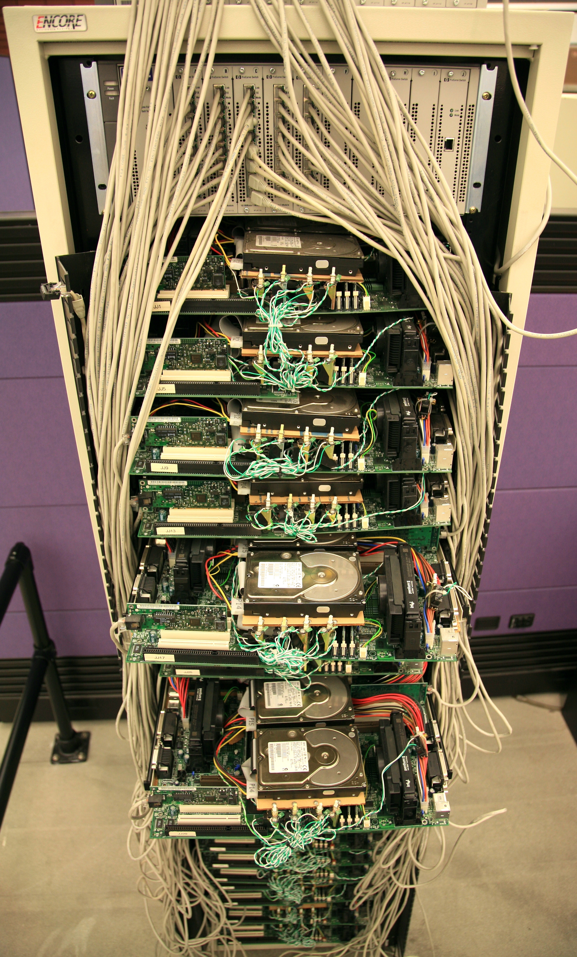
Make It Run Everywhere
What does an OSG machine have?
Prepare for very little
Bring as much as possible with you, including:
executable
likely, more of the “environment”

Slide 20
The Spectrum
Laptop (1 machine)
You control everything!
Local cluster (1000 cores)
You can ask an admin nicely
Campus (5000 cores)
It better be important/generalizable
OSG (50,000 cores)
Good luck finding the pool admins

Slide 21

Make It Work Everytime
What could possibly go wrong?
Eviction
Non-existent
dependencies
File corruption
Performance surprises
Network
Disk
…
Maybe even a bug in your code

Slide 22
Performance Surprises
One bad node can ruin your whole day
“Black Hole” machines
Depending on the error, email OSG!
REALLY slow machines
use periodic_hold / periodic_release

Slide 23
Error Checks Are Essential
If you don’t check, it will happen…
Check expected file existence, and repeat with a finite loop or number of retries
better yet, check rough file size too
Advanced:
RETRY for specific error codes from wrapper
“periodic_release” for specific hold reasons

Slide 24
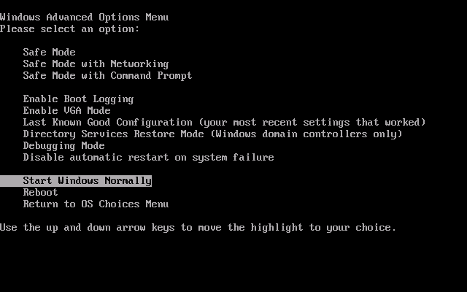
Handling Failures
Understand something about failure
Use DAG “RETRY”, when useful
Let the rescue dag continue…

Slide 25
Make It Run(-able) for Someone Else
Automation is a step towards making your research reproducible by someone else
Work hard to make this happen.
It’s their throughput, too.
Can benefit those who want to do similar work

Slide 26
Building a Good Workflow
Draw out the general workflow
Define details (test ‘pieces’ with HTCondor jobs)
divide or consolidate ‘pieces’
determine resource requirements
identify steps to be automated or checked
Build it modularly; test and optimize
Scale-up gradually
Make it work consistently
What more can you automate or error-check?
(And remember to document!)

Slide 27
Automate All The Things?
Well, not really, but kind of …
Really: What is the minimal number of manual steps necessary?
even 1 might be too many; zero is perfect!
Consider what you get out of automation
time savings (including less ‘babysitting’ time)
reliability and reproducibility

Slide 28
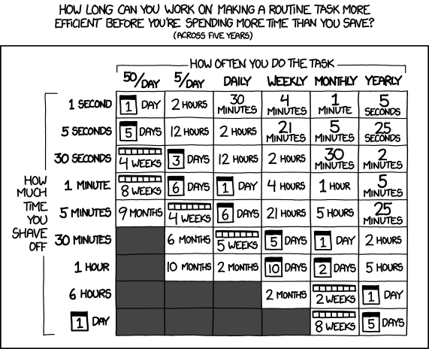
Automation Trade-offs
http://xkcd.com/1205/

Slide 29
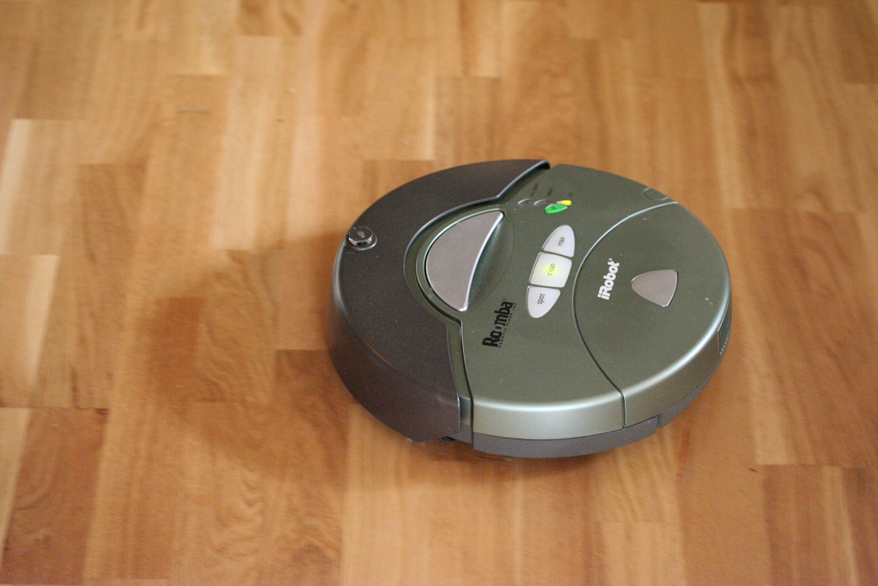
Make It Work Unattended
Remember the ultimate goal:
Automation! Time savings!
Potential things to automate:
Data collection
Data preparation and staging
Submission (condor cron)
Analysis and verification
LaTeX and paper submission ☺

Slide 30
Building a Good Workflow
Draw out the general workflow
Define details (test ‘pieces’ with HTCondor jobs)
divide or consolidate ‘pieces’
determine resource requirements
identify steps to be automated or checked
Build it modularly; test and optimize
Scale-up gradually
Make it work consistently
What more can you automate or error-check?
(And remember to document!)

Slide 31
Documentation at Multiple Levels
In job files: comment lines
submit files, wrapper scripts, executables
In README files
describe file purposes
define overall workflow, justifications
In a document!
draw the workflow, explain the big picture

Slide 32
parting thoughts

Slide 33
Getting Research Done
End goal: getting the research done
Hopefully you now have the tools to get the most out of:
Computing: which approach and set of resources suit your problem?
High Throughput computing: optimize throughput, use portable data and software
Workflows: test, automate and scale

Slide 34
Questions?
Now: Exercises 2.1 (2.2 Bonus)
Next:
Lunch
Discovery Tour + Group Photo
HTC Showcase!

